Slide 1

Active Transport
(mostly cycling)
John Symons
BikeWest

Slide 2
About BikeWest and me
BikeWest advocates for more people on bikes; that means better cycling infrastructure.
Better cycling infrastructure is just a means to an end, the end is healthier, wealthier and more connected life with a better urban environment
Research Fellow at the Victoria Institute for Strategic Economic Studies at VU but these views are mine only and do not represent the views of VU.
Areas of research include the analysing the economic benefits of road safety, health and education interventions among others eg
https://www.fiafoundation.org/news/millions-of-young-lives-lost-without-global-road-safety-investment-warns-new-fia-foundation-study

Slide 3
Who are you?
Are you a cyclist?
Perhaps a walk-ist?
Or a bus-ist?
Train-ist?
Tram-ist?
Ferry-ist?
Plane-ist?
Helicopter-ist?
Car-ist?

Slide 4
Cyclists in Australia!
If you cycle at all in Australia you are a “CYCLIST” even if you use other modes of transport
Hardly anyone in the Netherlands calls themselves a “cyclist”
Australian Cyclist = Middle Aged Man in Lycra (MAMIL)
Cycling = middle aged man’s indulgence or a child’s toy
Labelling reflects broader thinking
Impacts city design and transport investment decisions
Impacts quality of life
(Great video on this topic, Not Just Bikes Youtube Channel, “I’m not a cyclist” https://www.youtube.com/watch?v=vMed1qceJ_Q

Slide 5
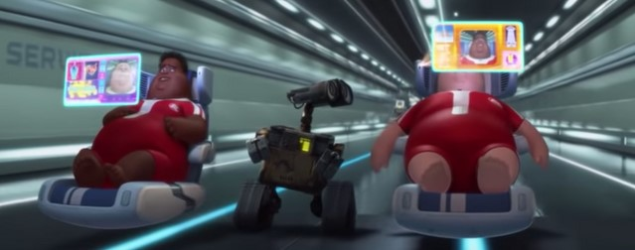
Should we encourage more people to cycle?
Well YES! Why?
Otherwise this is our future
So many benefits if it was a pill it would be worth trillions to any pharmaceutical company
“Pick any crisis and you’ll find cycling is part of the solution”: Chris Boardman Manchester Walking and Cycling Commissioner and Olympic Gold Medallist

Slide 6
Cycling: the Magic Pill
Benefits:
  Health (the Gym of Life)
  Economic
  Environmental/climate change
  Independent mobility for Children
  Transport poverty
  Education benefits
  Congestion reduction

Slide 7
Who does cycle? Who wants to cycle?
4 Types of Cyclists
  Strong and Fearless (MAMILs)
  Enthused and Confident
  Interested but Concerned
  No Way No How
Notes:
These are the people who will cycle regardless of roadway conditions. They are ‘cyclists;’ riding is a strong part of their identity and they are generally undeterred by roadway conditions
E&C: This group is relatively comfortable sharing the roadway with vehicular traffic, but they prefer to do so operating on their own bicycle facilities. They are attracted to cycling in streets that have been redesigned to make them work well for bicycling. They appreciate bicycle lanes and bicycle boulevards
IBC: These residents are curious about bicycling. They are hearing messages from a wide variety of sources about how cycling is booming in different cities, about the need for people to lead more active lives. They like riding a bicycle, remembering back to their youth, and they would like to ride more, however, they are afraid to ride on busy roads. They don’t like the cars speeding down their streets. They get nervous thinking about what would happen to them on a bicycle when a driver runs a red light, or cars passing too closely and too fast. Very few of these people regularly ride bicycles, they would ride if they felt safer on the roadways—if cars were slower and less frequent, and if there were more quiet streets with few cars and paths without any cars at all.
NWNH: This group is currently not interested in bicycling at all, for reasons of topography, inability, or simply a complete and utter lack of interest.

Slide 8
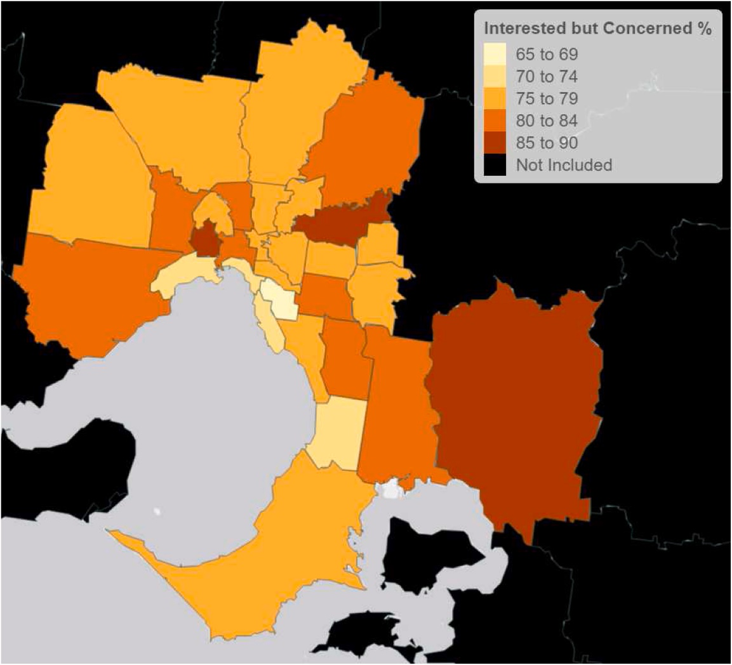
Interested but Concerned in Melbourne

Slide 9
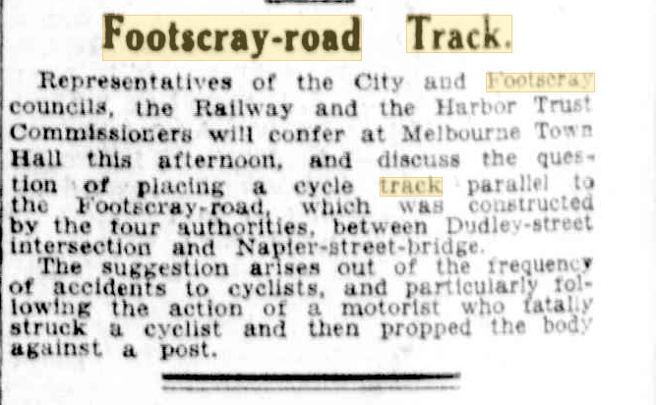
How do we do it?
Safety is Key, but not everything!
Infrastructure is the starting point NOT
  sharing the road nicely (first proposed 1913) or
  1 metre passing laws (ignored by ~20-30% of drivers)
Safe System Approach is Best Practice

Slide 10
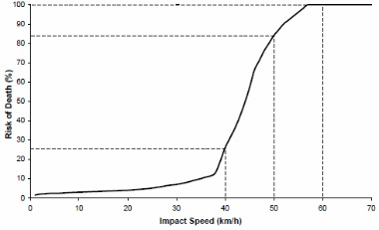
Safe System Approach
Principles :
  People make mistakes; no one should die or be seriously injured as a result of these mistakes.
  Human Vulnerability: the body has a limited ability to tolerate crash forces (key speed is 30km/h)
  Road Safety is a shared responsibility
  Build a safe and forgiving system
Informs Key Design Principles

Slide 11
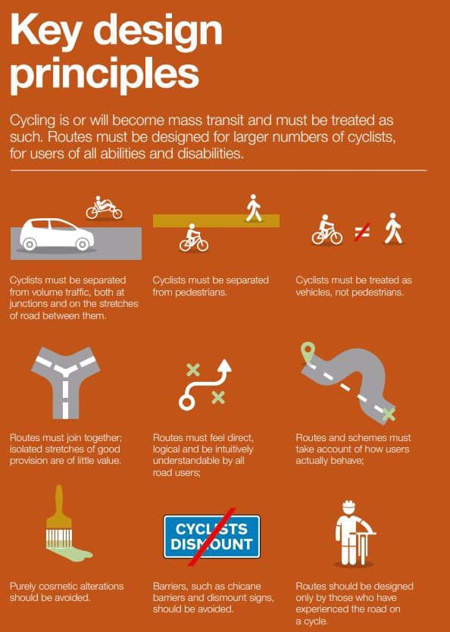

Slide 12
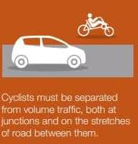
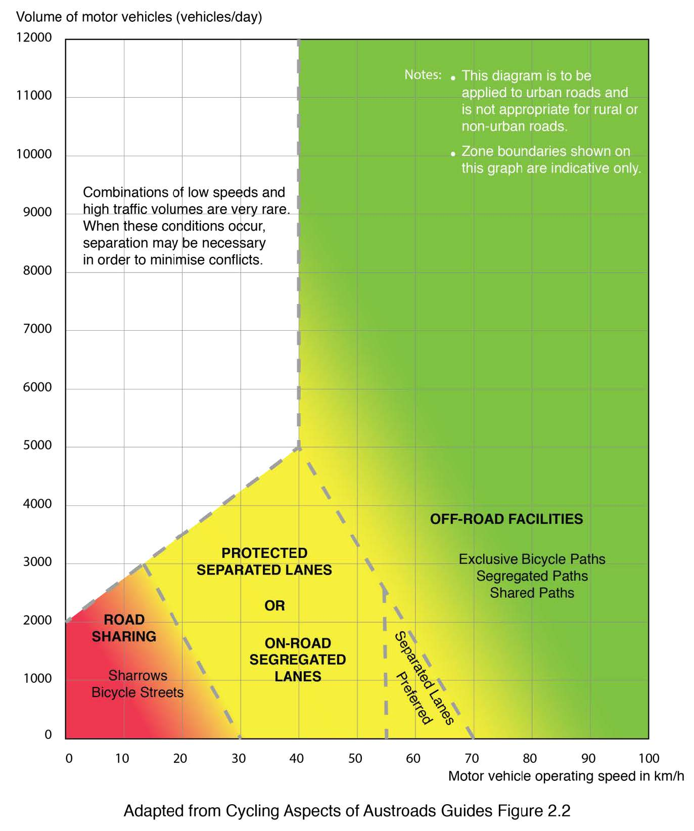
Separated from Volume Traffic

Slide 13
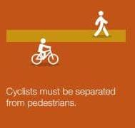
Separated from Pedestrians

Slide 14
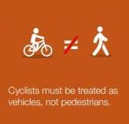
Treated as Vehicles

Slide 15
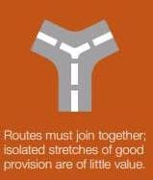
Routes must join together

Slide 16
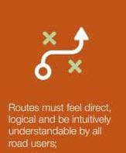
Routes must be logical

Slide 17
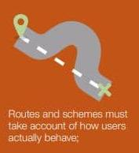
Routes must take into account preferences

Slide 18

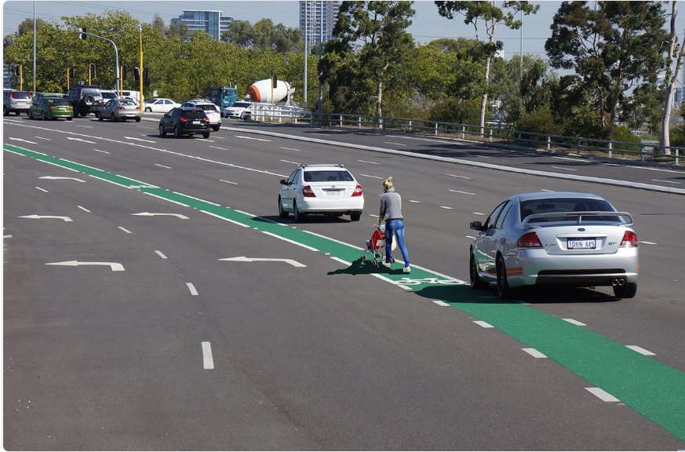
Cosmetic Changes should be avoided
(ie paint is not infrastructure)

Slide 19
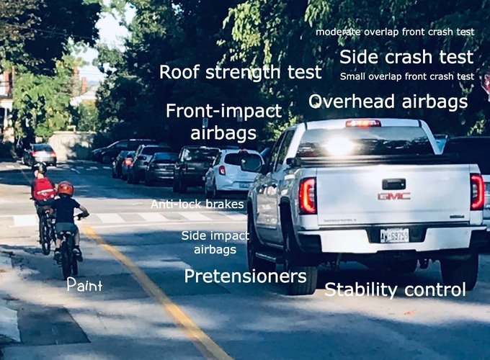
Cosmetic Changes should be avoided
(ie paint is not infrastructure)

Slide 20
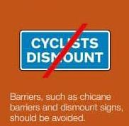
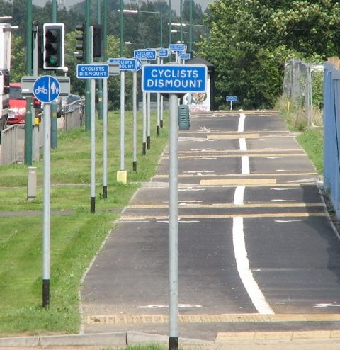
Barriers/Dismount must not be used

Slide 21
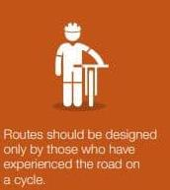
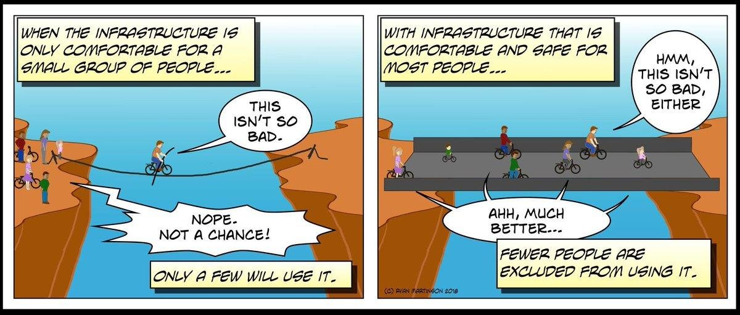
Designed by Cyclists
(except MAMILs)

Slide 22
WE DO EVERYTHING WRONG!!!!
We hardly ever separate cyclist from motorised traffic
We often put pedestrians and cyclists together
We never treat cyclists as vehicles
Routes nearly always have huge gaps so are completely disconnected and hence useless
Routes are often illogical and difficult to understand or navigate
Routes don’t take into account user behaviour/preferences
We nearly always resort to paint
We often put up barriers or dismount signs
If designers are cyclists they are nearly always Strong and Fearless and don’t understand the different risk tolerance of others.

Slide 23
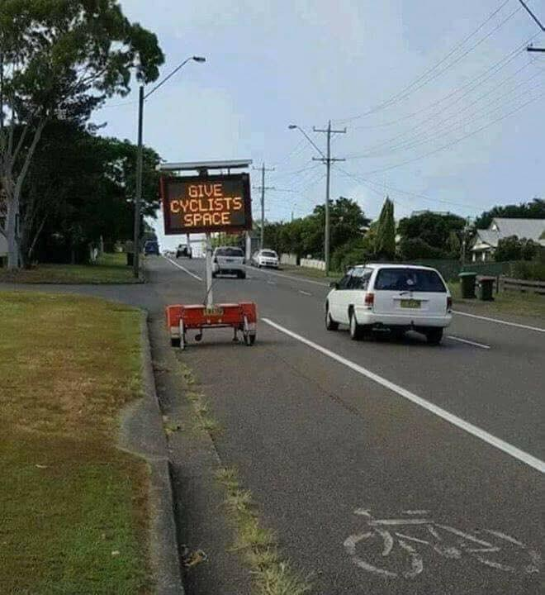
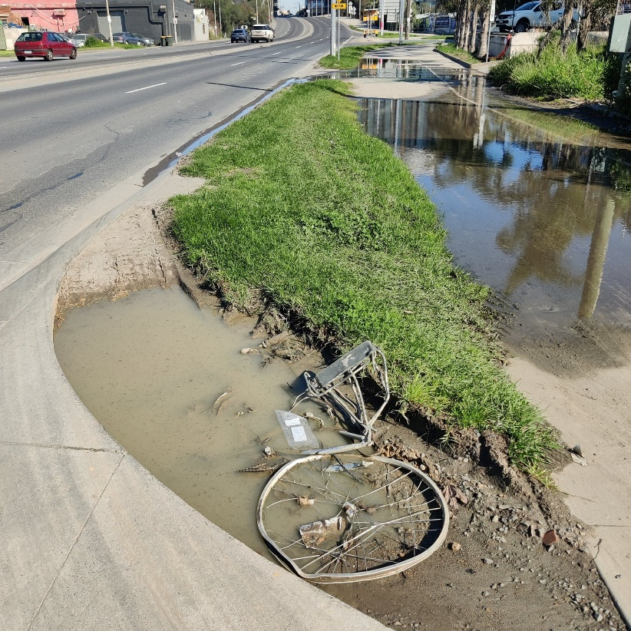
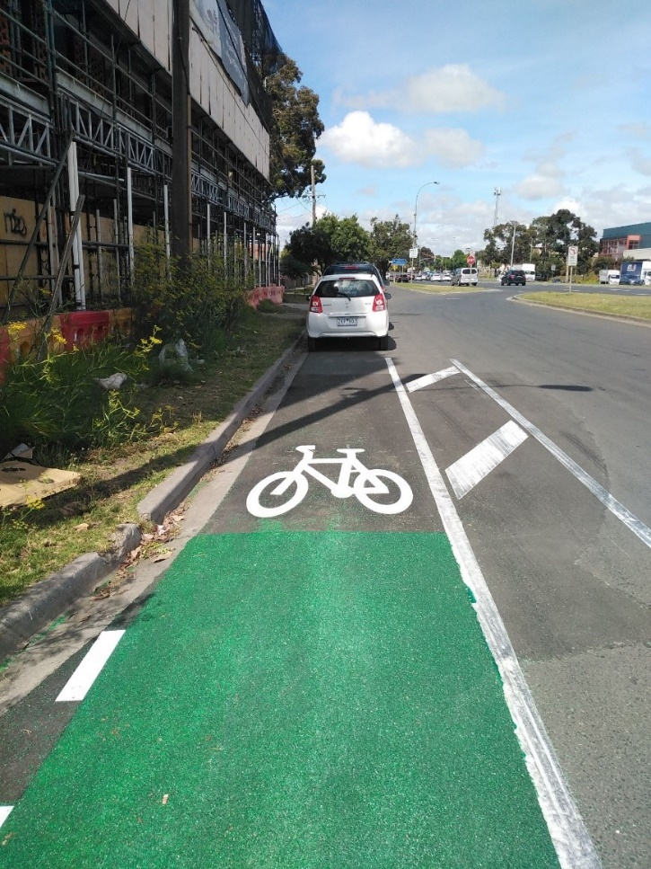
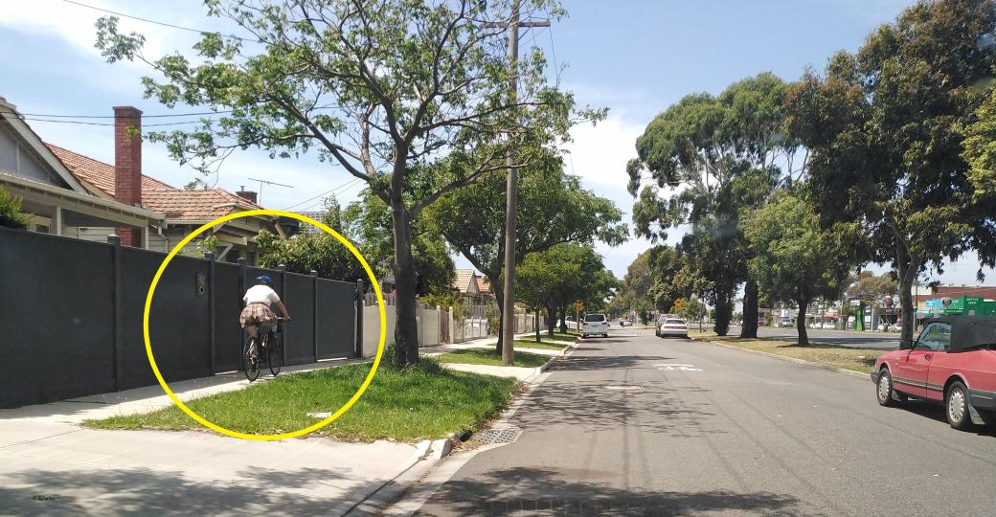
Bad Bike infrastructure:
Western Suburbs Style!

Slide 24



Bad Bike infrastructure:
Western Suburbs Style!

Slide 25
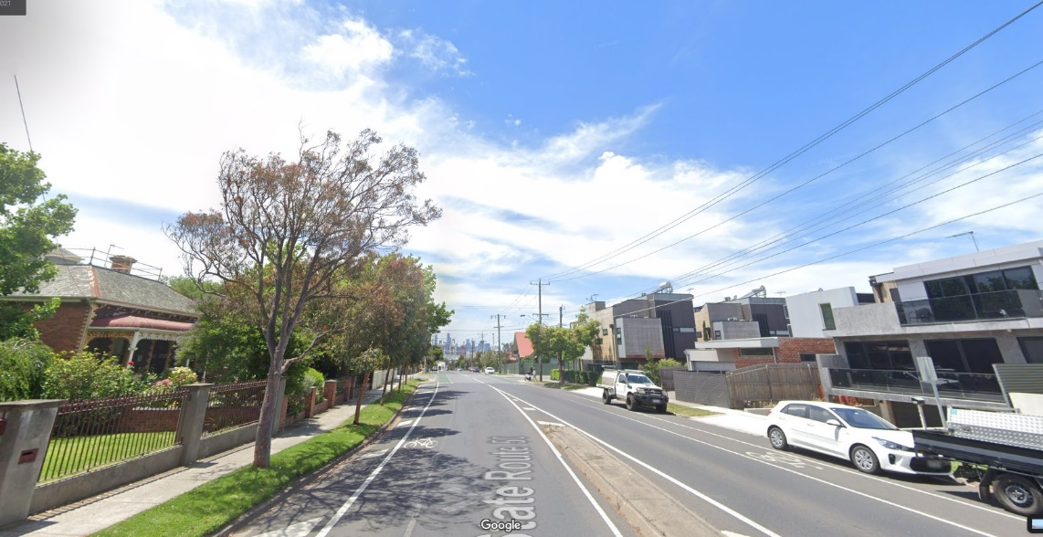
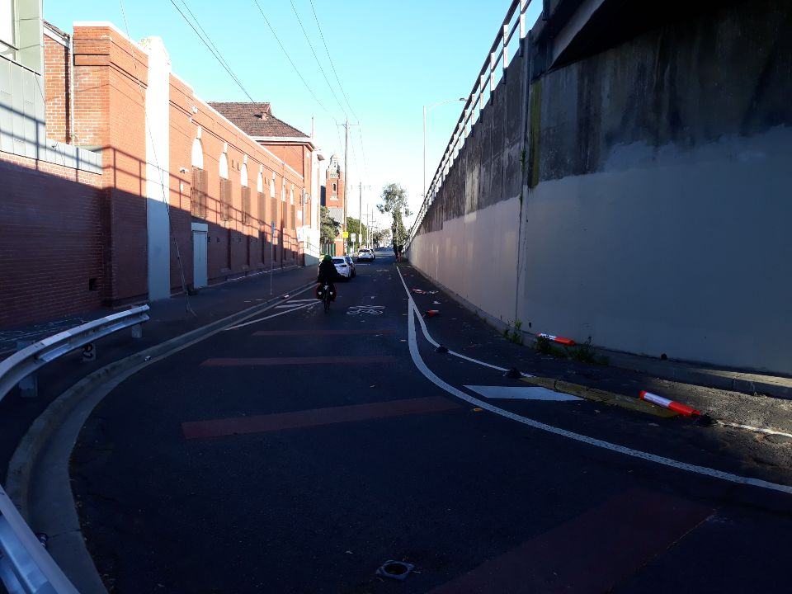
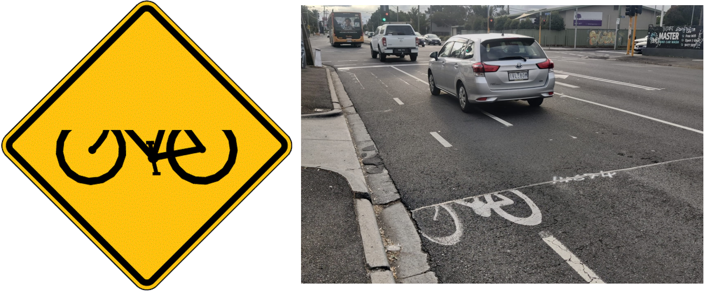
Bad Bike infrastructure:
Western Suburbs Style!

Slide 26
Why don’t we do it properly?
Every single cycling fallacy in the book comes out whenever cycling infrastructure is prioritised:
  Our roads are too narrow, You can’t remove car parks!! (some of the widest roads in the world, just a question of priorities)
  Shopkeepers rely on people driving (massively overestimated)
  Shops won’t get deliveries (Seriously? Shops don’t exist in the Netherlands or Denmark?)
  People on bike always break the rules (same % as car-ists)
  Cyclists don’t pay for roads (opposite is often true, rates or general revenue)
  We’re not Dutch (Amsterdam wasn’t Amsterdam in the 60s)
Many more on cyclingfallacies.com

Slide 27
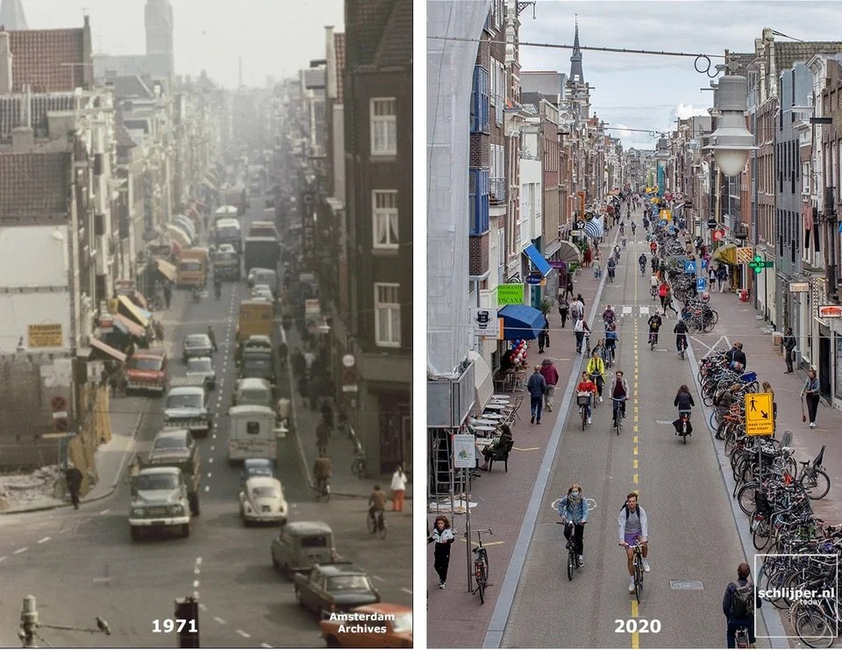
Amsterdam wasn’t Amsterdam!!
1971 and 2020

Slide 28
What’s needed?
On current rates will have a good cycling network in 180 years so something needs to be done!
Accept things need to change
Update standards to world’s best practice (Sharrows I’m looking at you!)
Infrastructure for AAA (All Ages and Abilities) to SSSS (Shops, Station, School, Stadia (sport or arts)) (50% of all trips are less than 4.3km)
Less NIMBYism
Professional development for professionals and education campaigns aimed at locals
Political will
A new approach? Invisible Cycling Infrastructure?

Slide 29
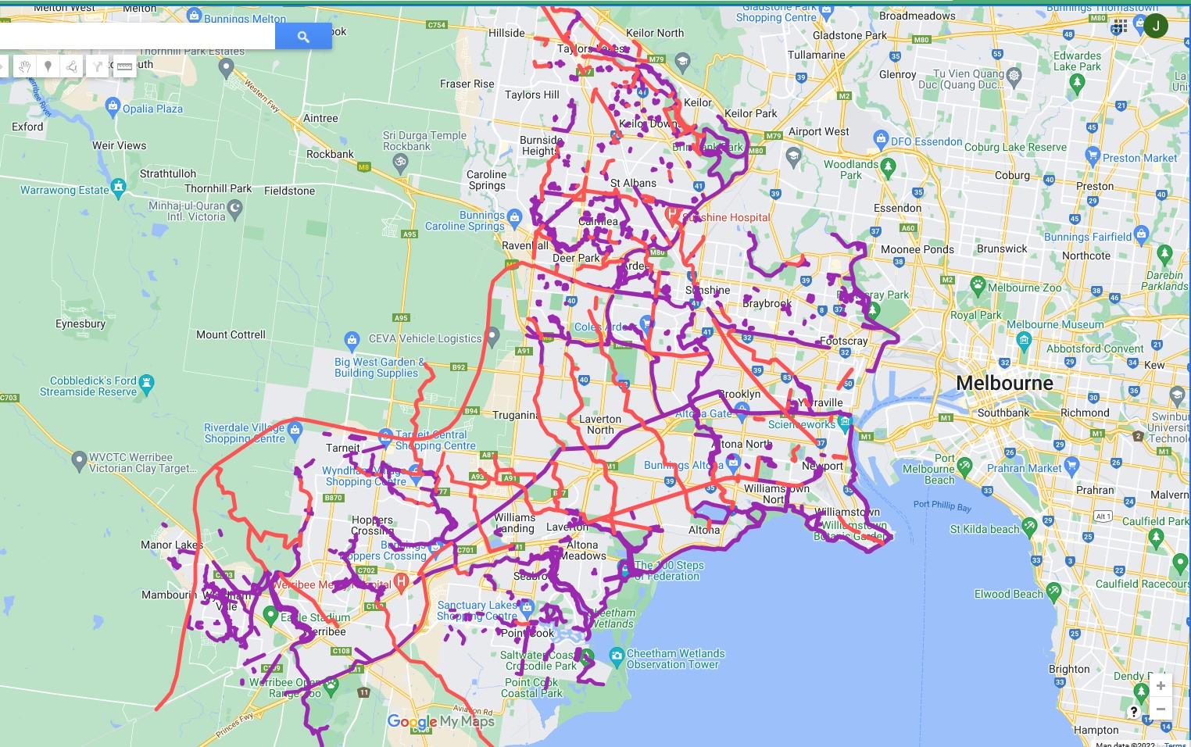
Invisible infrastructure?

Slide 30
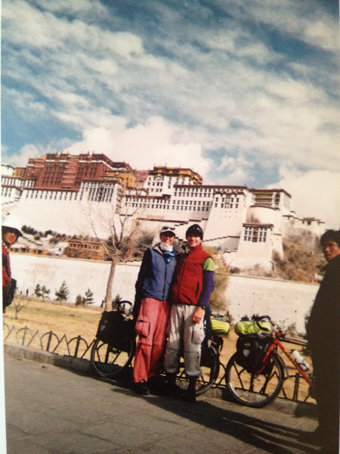
Thank you
Cycling can take you places!!
Please help us at BikeWest! We’re going a bit mad

